Slide 1
Cross-Core Prime+Probe Attacks on Non-inclusive Caches
Mengjia Yan, Read Sprabery, Bhargava Gopireddy,
Christopher Fletcher, Roy Campbell, Josep Torrellas
University of Illinois at Urbana-Champaign

Slide 2
Modern Cache Hierarchies
Modern systems are moving to non-inclusive cache hierarchies
Latest Intel server processor uses non-inclusive caches
Existing conflict-based attacks do not work on sliced non-inclusive caches
 | Skylake-S (Sep 2015) | Skylake-X/Skylake-SP (Jun 2017)
L2 | 256KB/core 16-way, inclusive | 1MB/core 16-way, inclusive
LLC | 2MB/core 16-way, inclusive | 1.375MB/core 11-way, non-inclusive
Core 0 | LLC Slice 0 | LLC Slice 4 | Core 4
Core 1 | LLC Slice 1 | LLC Slice 5 | Core 5
Core 2 | LLC Slice 2 | LLC Slice 6 | Core 6
Core 3 | LLC Slice 3 | LLC Slice 7 | Core 7

Slide 3
Challenges of Prime+Probe Attacks
Lack of Visibility into the Victim’s Private Cache
target address
eviction addresses
evict an
inclusion
victim
victim
cache 0
attacker
cache 1
victim
cache 0
attacker
cache 1
Victim’s line duplicates in L1 and L2
private
caches
Victim’s line does not exist in L2
eviction set (EV)
shared
cache
insert to LLC.
cache conflict.
insert to LLC.
No conflict
No inclusion victim
(a) inclusive cache
(b) non-inclusive cache

Slide 4
Challenges of Prime+Probe Attacks
Eviction Set Construction is Hard
target address
eviction address
private
caches
also insert to private cache
evict to
shared cache
insert to private cache
shared
cache
slice 1
Need LLC conflicts on the target slice to further evict the target line.
both evict to DRAM
slice 0
slice 0
slice 1
insert to shared cache
(b) non-inclusive cache
(a) inclusive cache
Eviction is affected by the replacement policies in multiple caches, and address slice distributions.
Eviction is only determined by the LLC replacement policy.

Slide 5
Contributions
We develop an algorithm to create Eviction Set on sliced non-inclusive caches.
We reverse engineer the directory structure in Intel Skylake-X processors.
We identify that directory as a unified structure to bootstrap conflict-based cache attacks for different cache hierarchies.
Based on our insights into the directory, we design the first Prime+Probe attack on sliced non-inclusive LLCs.
Previous attacks on inclusive caches are an example of directory attack.

Slide 6
The Inclusive Directory Structure
Insight: Directory must be inclusive to maintain tracking information for all the cache lines resident in the cache hierarchies.
directory entry
for lines in LLC
directory entry
for lines in L2 but not LLC
Attack opportunity analysis:
$$W_{ED}=12 { < W}_{L2}=16$$
LLC Slice
Directory and Tags
Cache Lines
Due to the associativity difference, we can create ED conflicts.
Can ED conflicts lead to inclusion victims?
 |  |  | ……
 |  |  | ……
 |  |  | ……
 |  |  | ……
 |  |  | ……
 |  |  | ……
Traditional
Directory
 |  | ……
 |  | ……
 |  | ……
Extended
Directory
(ED)
The new attack surface!

Slide 7
Creating Inclusion Victims via ED Conflicts
victim
core 0
attacker
core 1
cache
line
directory
entry
L2
 |  | ……
 |  | ……
 |  | ……
 |  | ……
target
address
evict the target line from remote L2 to LLC
probe
addresses
directories
cache lines
 |  | ……
 |  | ……
 |  | ……
 |  | ……
 |  | ……
 |  | ……
 |  | ……
 |  | ……
traditional
directory
inclusion victim
LLC
slice
extended
Directory
(ED)
 |  | ……
 |  | ……
 |  | ……
 |  | ……
insert into L2 and ED.
ED conflict.
Prime: access $W_{ED}$probe lines to occupy the target set in a ED slice
 |  | ……
 |  | ……

Slide 8
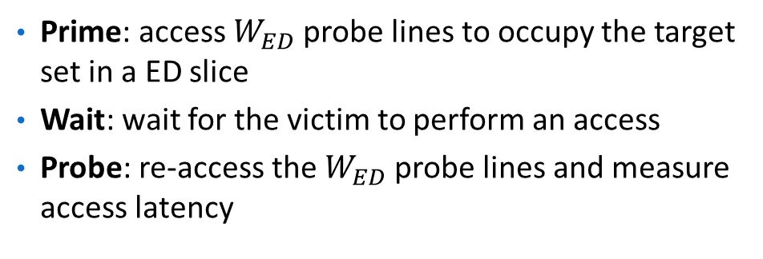
Prime+Probe Attacks Targeting the Directory
victim
core 0
attacker
core 1
cache
line
directory
entry
L2
 |  | ……
 |  | ……
 |  | ……
 |  | ……
target
address
probe
addresses
directories
cache lines
 |  | ……
 |  | ……
 |  | ……
 |  | ……
 |  | ……
 |  | ……
 |  | ……
 |  | ……
Prime: access $W_{ED}$probe lines to occupy the target set in a ED slice
Wait: wait for the victim to perform an access
Probe: re-access the $W_{ED}$probe lines and measure access latency
traditional
directory
LLC
slice
extended
Directory
(ED)
 |  | ……
 |  | ……
 |  | ……
 |  | ……
victim does not perform access
→ Probe latency is short

Slide 9
Prime+Probe Attacks Targeting the Directory
victim
core 0
attacker
core 1
cache
line
directory
entry
L2
 |  | ……
 |  | ……
 |  | ……
 |  | ……
target
address
① victim accesses target line
probe
addresses
directories
cache lines
 |  | ……
 |  | ……
 |  | ……
 |  | ……
 |  | ……
 |  | ……
 |  | ……
 |  | ……
Prime: access $W_{ED}$probe lines to occupy the target set in a ED slice
Wait: wait for the victim to perform an access
Probe: re-access the $W_{ED}$probe lines and measure access latency
traditional
directory
LLC
slice
extended
Directory
(ED)
 |  | ……
 |  | ……
 |  | ……
 |  | ……
②directory entry migration. ED conflict.
Victim performs access → Probe latency is higher

Slide 10
Conclusion
Directory = The unified structure for conflict-based cache attacks
“Attack Directories, Not Caches: Side-Channel Attacks in a Non-Inclusive World” recently accepted in IEEE Symposium on Security and Privacy (SP’19).
More in the Paper
Eviction set construction algorithm.
Steps of reverse engineering the directory structure.
Root cause analysis of the the vulnerability
A multi-threaded high-bandwidth Evict+Reload attack.
Attack results on AMD machines.

